Slide 1
OPSWAT Vietnam Center
Individual Innovation day
Topic 1: Metascan Online uploader for MAC OS X and Linux
ble@opswat.com
Jul. 2014

Slide 2

Innovation Day
Solution
Using Qt SDK
What is Qt?
The C++ based cross-platform development framework for building devices, user interfaces and applications.
“Write once compile every where”
Develop only one source code and deploy to many operating system such as Windows, MAC OS X, Linux
Developer can easily reuse the source code not 100% but maybe more than 90%

Slide 3
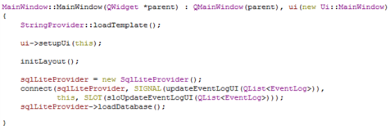




Innovation Day
Solution
Using Qt SDK
Install Qt SDK for Windows
Compile
Install Qt SDK for MAC
Compile
Install Qt SDK for Linux
Compile

Slide 4
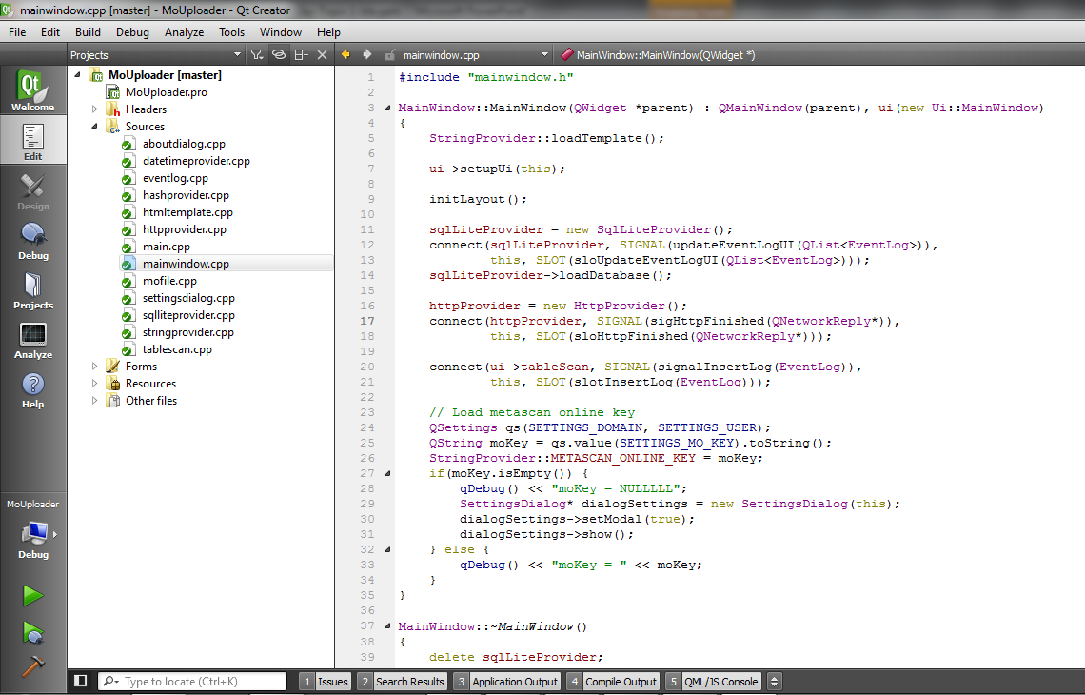
Innovation Day
Solution
Using Qt Creator
An IDE support a tool to design and develop applications with the Qt SDK.

Slide 5
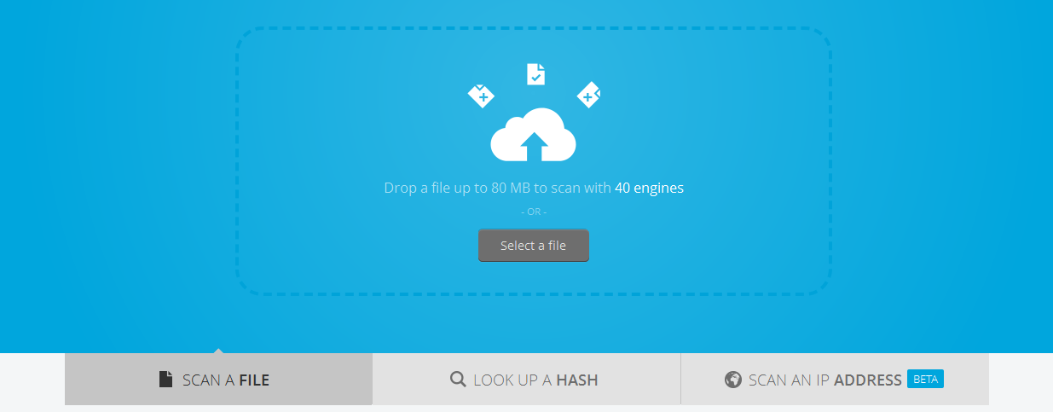
Innovation Day
Metascan Online Public API
Metascan Online Public API
Scan a file
Look up a hash
Scan IP

Slide 6
Innovation Day
Compile & Run
Test on MAC OS X 10.9, 10.8, 10.7
Install XCODE
Install Command Line Tool
Install Qt SDK 5.3
cd /source
qmake
make

Slide 7
Innovation Day
Compile & Run
Test on Ubuntu desktop 14 32 bit
Install gcc: apt-get install build-essential
Install OpenGL: sudo apt-get install freeglut3 freeglut3-devs
Install Qt SDK 5.3
cd /source
qmake
make

Slide 8
Innovation Day
Compile & Run
Test on windows 7 64 bit
Install Qt SDK 5.3
cd /source
qmake
mingw32-make

Slide 9
Innovation Day
Demo
Main Features
Free of setting Metascan Online Key
Support drag&drop and upload multiples files at the same time
Look up MD5/SHA1/SHA256 hash to retrieve the report
Scan an IP Address
Eventlog for scan history

Slide 10
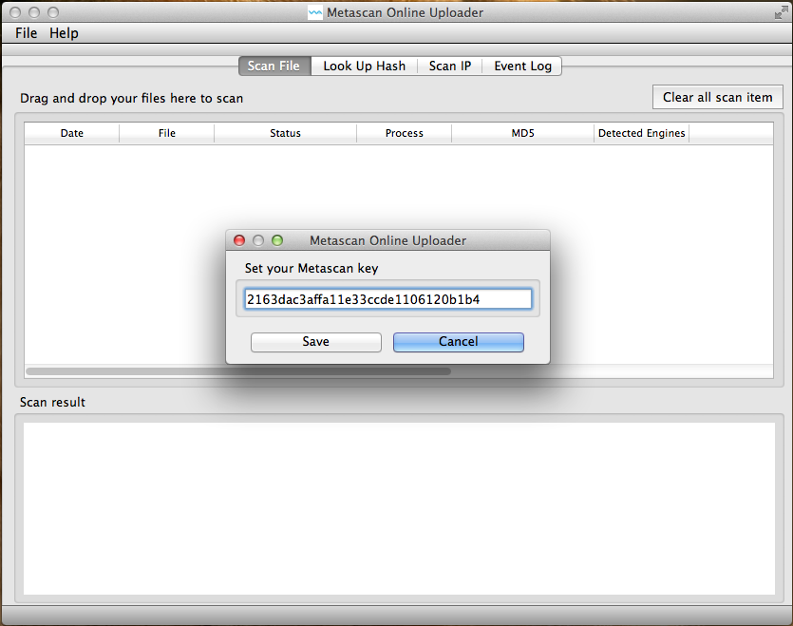
Innovation Day
Demo
MAC OSX

Slide 11
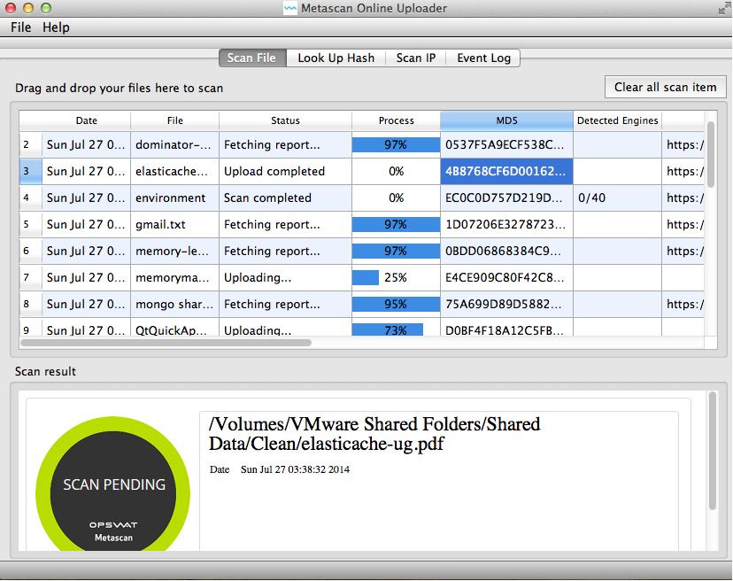
Innovation Day
Demo
MAC OSX

Slide 12
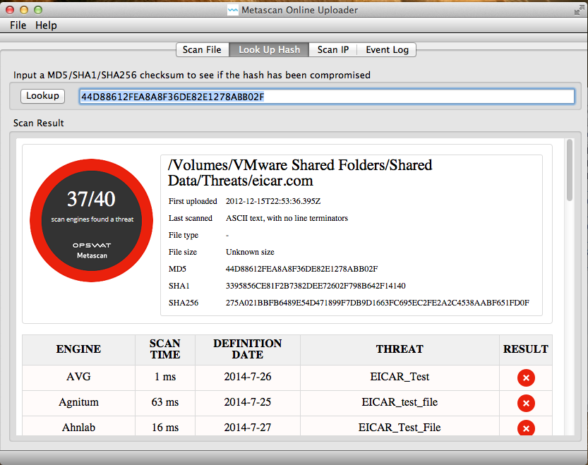
Innovation Day
Demo
MAC OSX

Slide 13
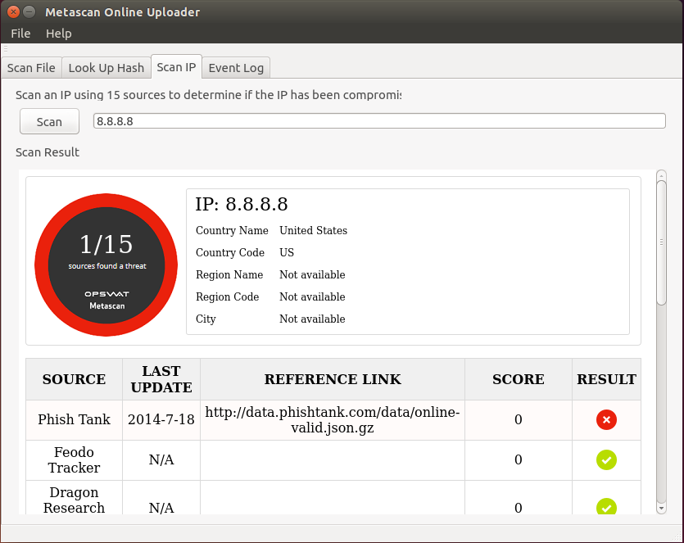
Innovation Day
Demo
Ubuntu 14

Slide 14
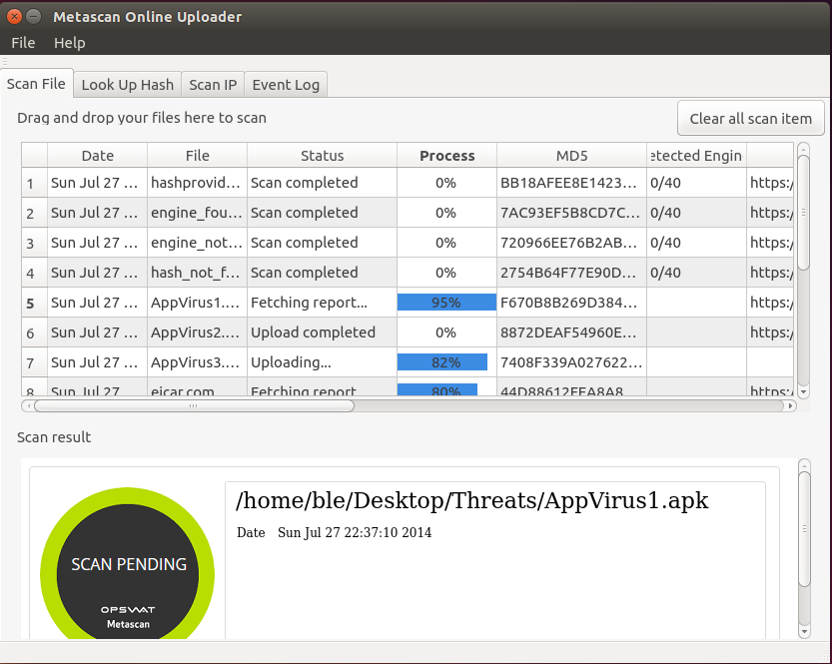
Innovation Day
Demo
Ubuntu 14

Slide 15
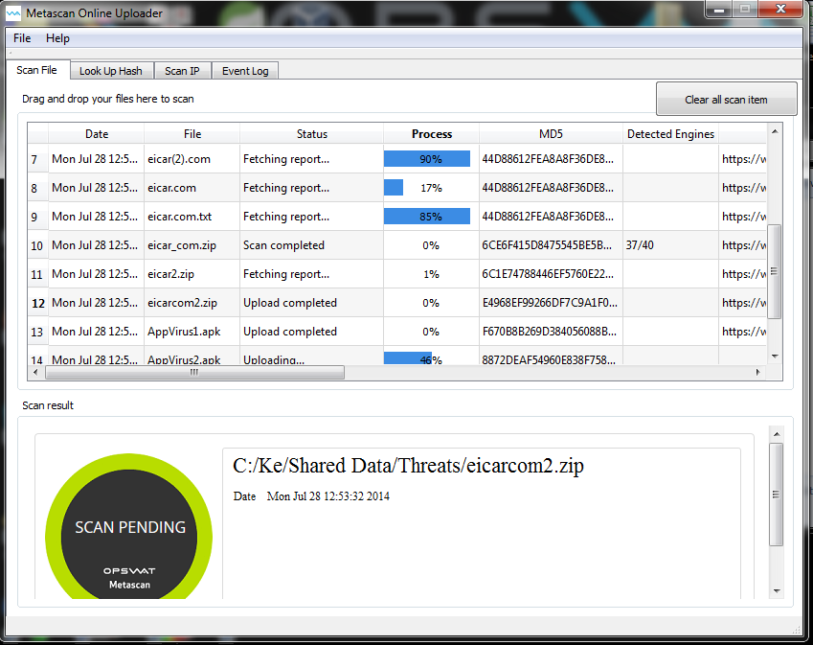
Innovation Day
Demo
Windows 7

Slide 16
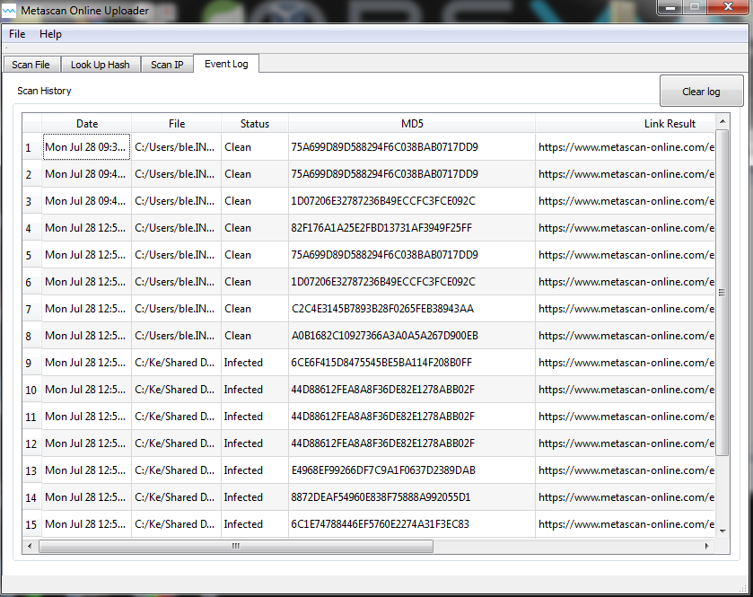
Innovation Day
Demo
Windows 7

Slide 17
Innovation Day
Demo
Windows 7

Slide 18

Innovation Day
Limitation
The UI is inconsistent for each platform

Slide 19
Innovation Day
Limitation
Upload many heavy files at the same time
Some potential bugs because it is none of QA.

Slide 20
Innovation Day
References
http://qt.digia.com
https://www.virustotal.com/en/documentation/desktop-applications/mac-osx-uploader
https://github.com/VirusTotal/qt-virustotal-uploader

Slide 21
Innovation Day
The end
Thank you

